Slide 1

Probabilistic Dynamic Semantics
Aaron Steven White
University of Rochester
S-Babble Talk
UCSD
19 November 2024

Slide 2
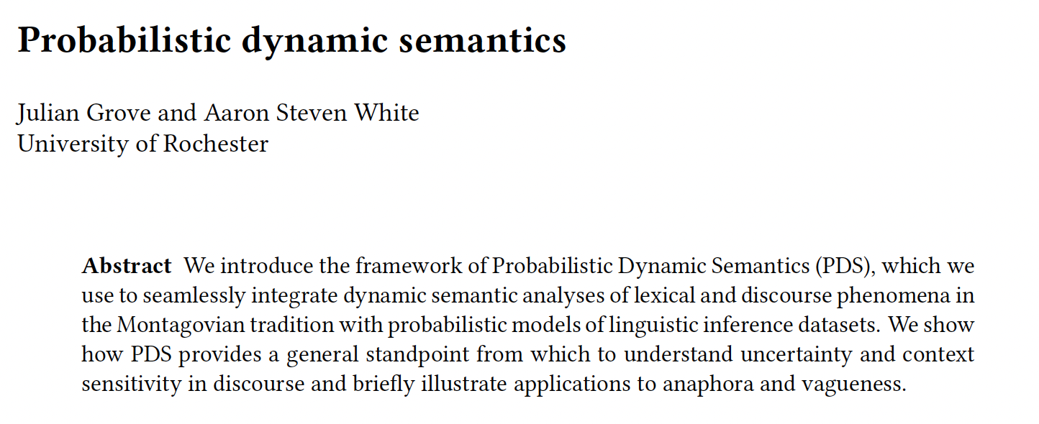
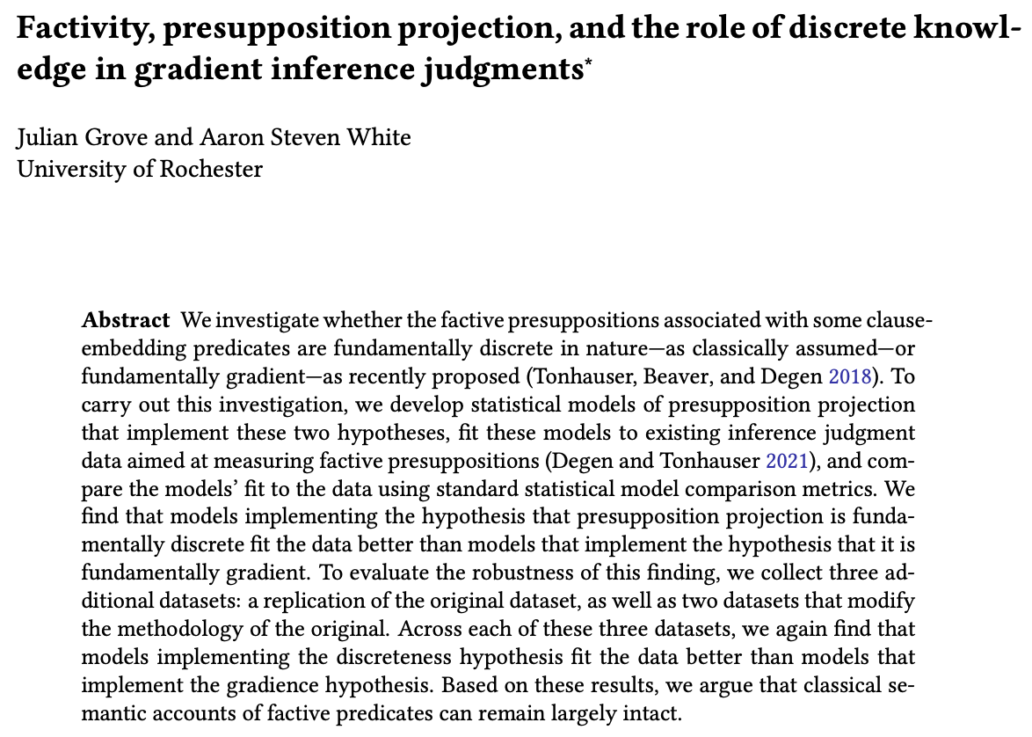


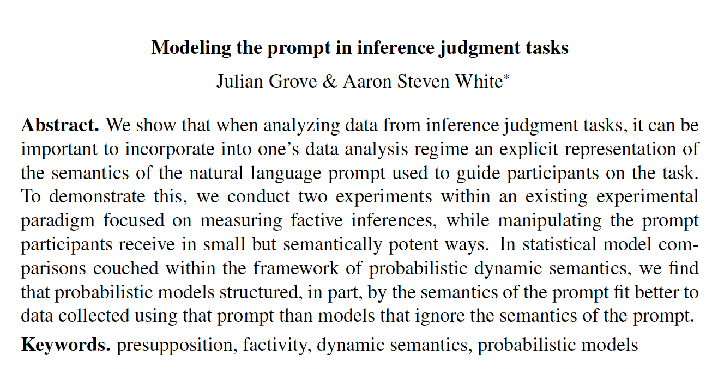
Julian Grove
University of Rochester

Slide 3
Prior Approach #1
Karttunen 1976; Kamp 1981; Heim 1982; Heim 1983; Groenendijk and Stokhof 1990; Groenendijk and Stokhof 1991; Kamp and Reyle 1993; Asher 1993; Dekker 1993, i.a
Dynamic semantic frameworks provide powerful tools for characterizing what we can and cannot mean in using linguistic expressions.

Slide 4



Whenever anyone laughed, the magician scowled and their assistant smirked.
anyone
the magician
their assistant
They were secretly pleased.
They
Discourse referents
Who was secretly pleased?
The magician.
Their assistant.
The magician and their assistant.
The laugher(s).

Slide 5
Prior Approach #1
Karttunen 1976; Kamp 1981; Heim 1982; Heim 1983; Groenendijk and Stokhof 1990; Groenendijk and Stokhof 1991; Kamp and Reyle 1993; Asher 1993; Dekker 1993, i.a
Dynamic semantic frameworks provide powerful tools for characterizing what we can and cannot mean in using linguistic expressions.
Important Property
In their modern forms, these characterizations are compositional and modular.
Shan 2002; Barker 2002; Barker and Shan 2014; Charlow 2014; Bumford and Charlow 2022, i.a.
Muskens 1996; de Groote 2006, i.a

Slide 6
Challenge
Dynamic semantic frameworks don’t generally provide an apparatus for characterizing uncertainty about what we can mean in using linguistic expressions.

Slide 7
Whenever anyone laughed, the magician scowled and their assistant smirked.
They were secretly pleased.
Who was secretly pleased?
The magician.
The magician.
Their assistant.
Their assistant.
The magician and their assistant.
The magician and their assistant.
The laugher(s).

Slide 8
Challenge
Dynamic semantic frameworks don’t generally provide an apparatus for characterizing uncertainty about what we can mean in using linguistic expressions.
Result
Hinders our ability to use them to make fine-grained predictions about comprehenders’ inferences.

Slide 9
Frank and Goodman 2012; Goodman and Lassiter 2015; Cooper et al. 2015; Goodman and Frank 2016; Bergen et al. 2016; Franke and Jäger 2016; Lassiter and Goodman 2017; Zeevat et al. 2017 Bernardy et al. 2019; Degen et al. 2020; Erk and Herbelot 2023; i.a.
Prior Approach #2
Frameworks for probabilistic semantics and pragmatics provide us powerful tools for characterizing uncertainty about what we can mean in using linguistics expressions.
Challenge
No generic structure-preserving method for mapping between dynamic analyses and probabilistic analyses.

Slide 10
Goal
Develop a framework that views probabilistic reasoning as arising from a module that can be added to a dynamic semantic analysis without changing its structure.
Upshot
Allows us to distinguish different kinds of uncertainty at a fine level of granularity.

Slide 11
Feature #1: Compositionality
Complex probabilistic semantic values are derived from simpler ones using a standard type composition scheme.
Use monads!
Feature #2: Modularity
Traditional semantic analyses may be lifted into the probabilistic setting w/o tampering w/ their core structure.

Slide 12
Feature #3: Formal Evaluability
Probabilistic dynamic semantic values can be compiled to statistical models whose relative fits to experimental data can be quantitatively compared.
Can be combined with frameworks for probabilistic pragmatics, like Rational Speech Acts!

Slide 13
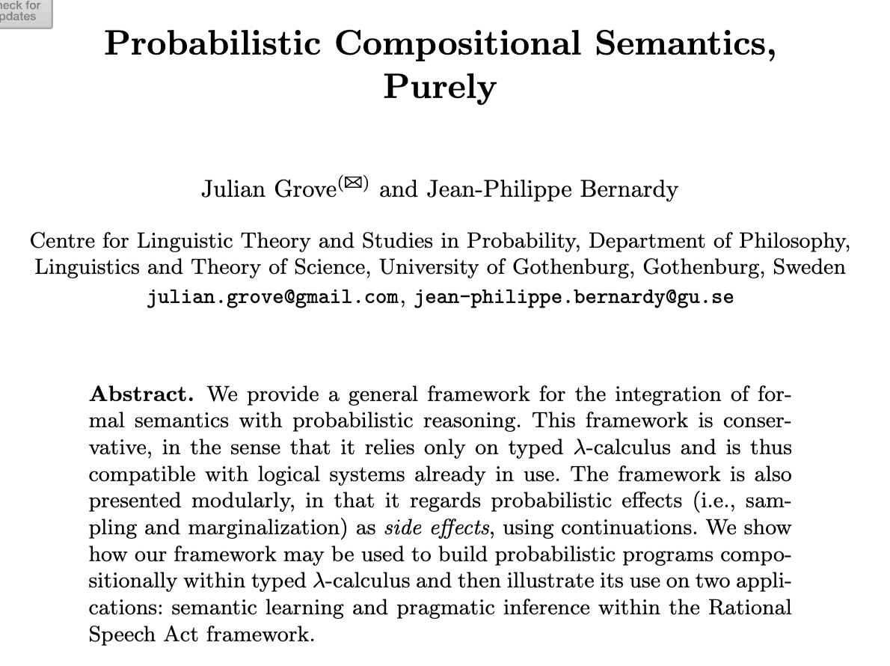
Julian Grove
University of Rochester

Slide 14
Part 1
How do monads support modularity?
Part 2
How do we integrate monads with frameworks for formal pragmatics?
Part 3
How do we compile probabilistic semantic values to statistical models?

Slide 15
Modularity

Slide 16
Idea Grove and Bernardy 2023
Use monads to describe expressions as probabilistic programs that (randomly) return things of a particular type.
Why monads? Shan 2001, Asudeh & Giorgolo 2010, Charlow 2014
Provide modular way of modeling semantic phenomena by enriching compositional core w/o fundamentally altering it.

Slide 17
Part 1
Elementary example of a monad for modeling anaphora, with aim of demonstrating what we mean by modular.
Part 2
Develop a monad for modeling uncertainty with an example application to characterizing vagueness.
Part 3
Show how the two monads can be composed to model referential uncertainty.

Slide 18
Modularity
An elementary example

Slide 19
Example: Anaphora Giorgolo & Unger 2009, Charlow 2014
Enrich the compositional procedure with a mechanism (a state) for representing active discourse referents.
see also classical dynamic approaches: Heim 1983, Kamp & Reyle 1993, i.a.

Slide 20

Composition Rule: Function Application
[[X Y]] = [[X]] [[Y]] if [[X]]: a -> b and [[Y]]: b
[[Y]] [[X]] if [[Y]]: a -> b and [[X]]: b
Appl [[X]] [[Y]]
angry c & leave y
Assignment function
λp.p & leave y
angry c
leave y
c
angry
λq.λp.p & q
y
leave
Cleo
was angry
and
she
left

Slide 21
Composition Rule: State-Sensitive Function Application
Extract the core semantic values and put them together normally.
Update the state with the first, then feed the updated state to the second to get a combined state.
Charlow 2014
[[X Y]] = λs.<Appl A B, s’’>
where <A, s’> := ([[X]] s)
<B, s’’> := ([[Y]] s’)
angry c & leave y
c
λs.<angry c & leave (head c::s), c::s>
λs.<λϕ.p & leave (head s), s’>
λp.p & leave y
where <p, s’> := ϕ(s)
λs.<angry c, c::s>
angry c
leave y
λs.<leave (head s), s>
λs.<c, c::s>
λs.<angry, s>
c
angry
λs.<λψ.λϕ.p & q, s’’>
λs.<head s, s>
y
leave
λs.<leave, s>
Cleo
was angry
and
she
left
where <p, s’> := ϕ(s)
<q, s’’> := ψ(s’)
Giorgolo & Unger 2009

Slide 22
Question
How do monads provide a modular way of modeling semantic phenomena by enriching a compositional core?
Answer
Monads satisfy metacompositional constraints that…
…ensure they don’t change how the core works.
…that allows different monadic enrichments of the compositional core to function independently.

Slide 23
Component #1: return
Some semantic values are monadic while others must be lifted into the monad in a way that doesn’t alter the core.

Slide 24
e
[[Cleo]] = λs.<c, c::s>
Fundamentally monadic because it introduces a discourse referent to be tracked.
[[was angry]] = angry
Not monadic because it doesn’t introduce a discourse referent.
e -> t
Composition Rule: State-Sensitive Function Application
[[X Y]] = λs.<Appl A B, s’’>
where <A, s’> := ([[X]] s)
<B, s’’> := ([[Y]] s’)
[[X]] = λs.<[[X]], s>
[[was angry]] = λs.<angry, s>: e -> t
Charlow 2014

Slide 25
Composition Rule: State-Sensitive Function Application
Charlow 2014
[[X Y]] = λs.<Appl A B, s’’>
where <A, s’> := ([[X]] s)
<B, s’’> := ([[Y]] s’)
angry c & leave y
c
λs.<angry c & leave (head c::s), c::s>
λs.<λϕ.p & leave (head s), s’>
λp.p & leave y
where <p, s’> := ϕ(s)
λs.<angry c, c::s>
angry c
leave y
λs.<leave (head s), s>
λs.<c, c::s>
λs.<angry, s>
c
angry
λs.<λψ.λϕ.p & q, s’’>
λs.<head s, s>
y
leave
λs.<leave, s>
Cleo
was angry
and
she
left
where <p, s’> := ϕ(s)
<q, s’’> := ψ(s’)

Slide 26
Component #1: return
Some semantic values are monadic while others must be lifted into the monad in a way that doesn’t add info.
Component #2: bind
We compose monadic semantic values by (roughly):
Combining core part of one with core part of another.
Wrapping the result back up as a monadic value.

Slide 27
ma >>= λx → (f(x) >>= g) ↔ (ma >>= f) >>= g
Composition Rule: State-Sensitive Function Application
[[X Y]] = λs.<Appl A B, s’’>
where <A, s’> := ([[X]] s)
<B, s’’> := ([[Y]] s’)
(>>=) : a -> (a -> b ) -> b
[[A B]] := [[A]] >>= λx [[B]] >>= λy Appl x y
Monad Laws
x >>= f = f x
f >>= λx x = f
h >>= λx (f(x) >>= g) = (h >>= f) >>= g

Slide 28
Modularity
Modeling uncertainty

Slide 29
Idea Grove and Bernardy 2023
Use monads to describe expressions as probabilistic programs that (randomly) return things of a particular type.
Proximal Goal
Develop a monad for modeling uncertainty and give an example application for characterizing vagueness.
This approach will only be a first stab and we’re going to need to generalize it!

Slide 30
Leo ran a marathon in 3:40.
?
Leo’s marathon was fast.

Slide 31
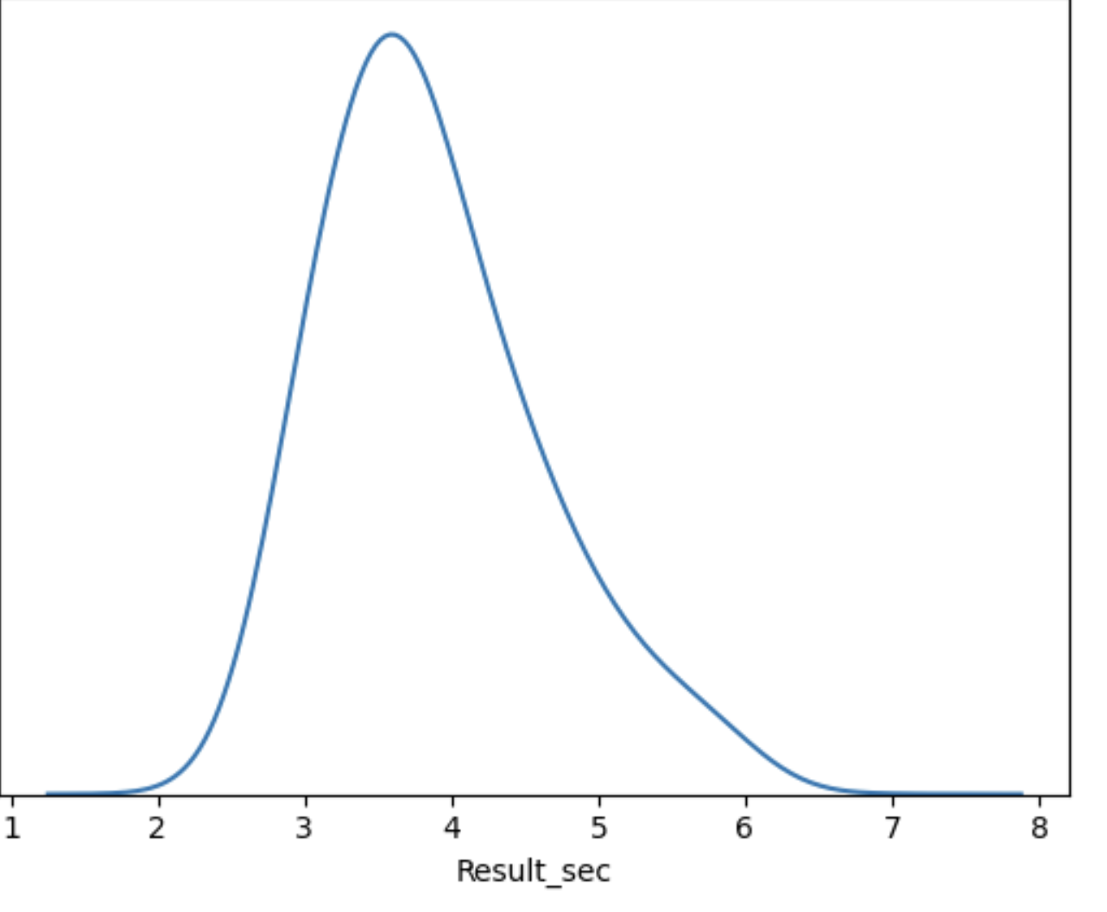
Leo’s marathon

Slide 32
2
3
4
5
6
7
Assignment function
speed(m) > θ
m
λx.speed(x) > θ
Leo’s marathon
was fast

Slide 33
2
3
4
5
6
7
speed(m) > 3.25
Randomly returns truth values.
speed(m) > 3.22
t
speed(m) > 3.15
speed(m) > θ
speed(m) > 2.91
Randomly returns functions from entities to truth values.
λx.speed(x) > 3.25
Deterministically returns m.
λx.speed(x) > 3.22
e
e -> t
m
λx.speed(x) > θ
λx.speed(x) > 3.15
λx.speed(x) > 2.91
Leo’s marathon
was fast

Slide 34
Extract core semantic value type a from probabilistic program by sampling from it.
Feed extracted value of type a to this to get probabilistic program returning b.
(>>=) : a -> (a -> b ) -> b
New probabilistic program returning b.
[[A B]] := [[A]] >>= λx [[B]] >>= λy Appl x y
Sample from [[A]] and call the result x.
Sample from [[B]] and call the result y.
Apply y to x and return the result.

Slide 35
Composition Rule: State-Sensitive Function Application
[[X Y]] = λs.<Appl A B, s’’>
where <A, s’> := ([[X]] s)
<B, s’’> := ([[Y]] s’)
Composition Rule: Probabilistic Function Application
[[X Y]] = Appl A B
where A ~ [[X]]
B ~ [[Y]]

Slide 36
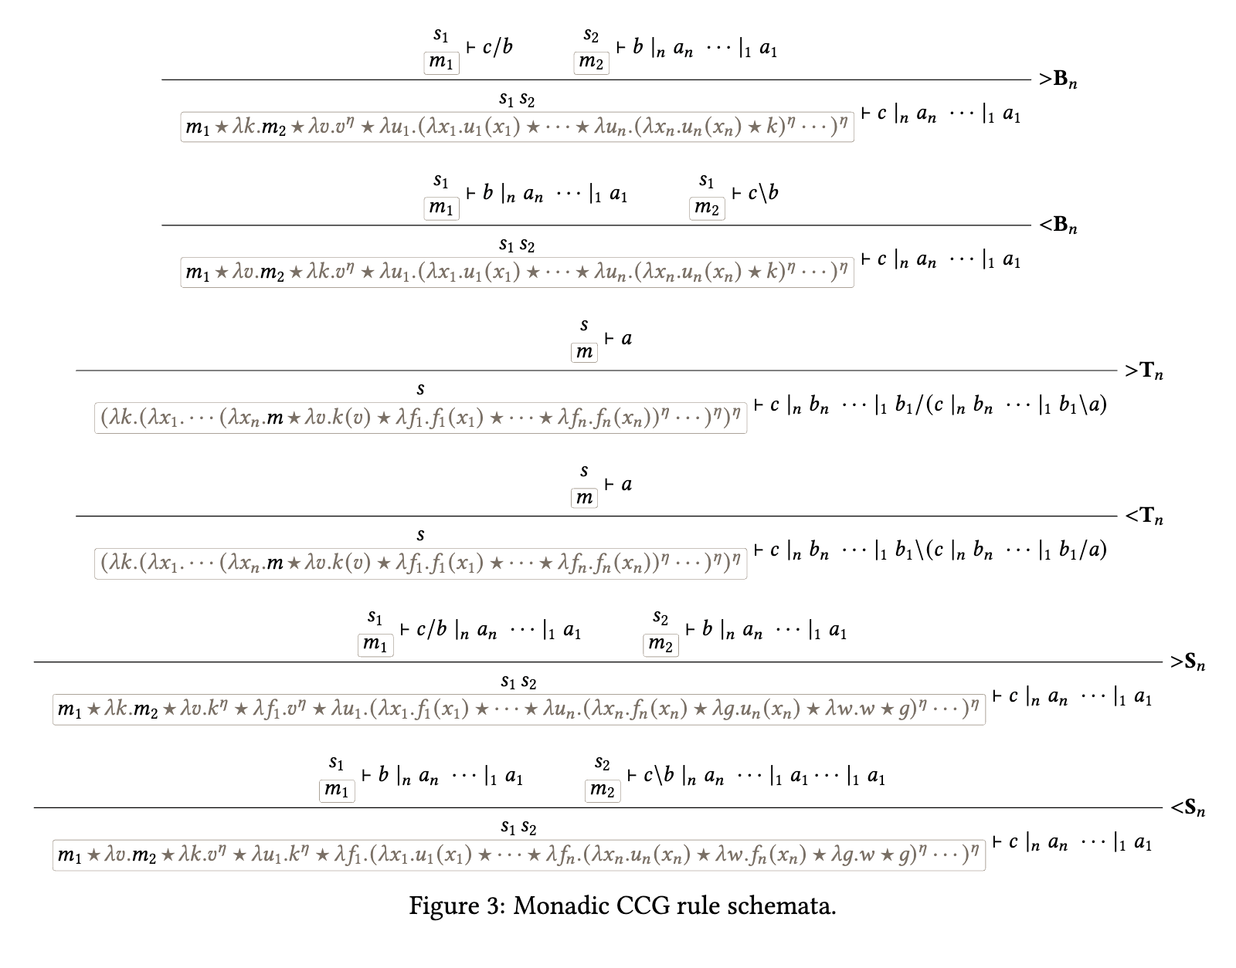

Slide 37
Challenge
This approach doesn’t allow us to capture how contexts modulate uncertainty about a parameter.
Example
If we are talking about elite marathoners, θ will have a very different distribution than if we are talking about novices.

Slide 38
Assumption #1
Common grounds are probability distributions on contexts. (Think of contexts as possible worlds for now.)
Stalnaker 1978 et seq, see Lassiter 2011, Bergen et al. 2012, 2016, Lassiter & Goodman 2013, i.a.

Slide 39
c
c
c
c
c
κ
c
c
c
c
c
c
c

Slide 40
Assumption #1
Common grounds are probability distributions on contexts. (Think of contexts as possible worlds for now.)
Assumption #2
Assertions are ways of building probability distributions on truth values from contexts.
Stalnaker 1978 et seq, see Lassiter 2011, Bergen et al. 2012, 2016, Lassiter & Goodman 2013, i.a.

Slide 41
Leo’s marathon was fast.
c
c
c
c
c
c
c
c
c
c
c
c
κ
false
true
Barker 2002 Kennedy and McNally 2005, Kennedy 2007, Lassiter 2011; Lassiter and Goodman 2013; Bernardy et al. 2018, i.a.

Slide 42
Leo’s marathon was fast.
c
c
c
c
c
c
c
c
c
c
c
c
c
c
c
c
c
c
c
c
c
c
c
c
κ
false
true
Barker 2002 Kennedy and McNally 2005, Kennedy 2007, Lassiter 2011; Lassiter and Goodman 2013; Bernardy et al. 2018, i.a.

Slide 43
Formal Component #1
Common grounds as probabilistic programs (monadic values) from which we can sample (return) contexts.
Stalnaker 1978 et seq, see Lassiter 2011, Bergen et al. 2012, Lassiter & Goodman 2013, i.a.

Slide 44
Leo’s marathon was fast.
κ
κ
c
c
c
c
c
c
c
c
c
c
c
c
c
c
c
c
c
c
c
c
c
c
c
c
Barker 2002 Kennedy and McNally 2005, Kennedy 2007, Lassiter 2011; Lassiter and Goodman 2013; Bernardy et al. 2018, i.a.

Slide 45
Formal Component #1
Common grounds as probabilistic programs as monadic values randomly returning contexts.
Formal Component #2
Assertions as mappings from contexts to probabilistic programs (monadic vals) randomly returning truth values.
Stalnaker 1978 et seq, see Lassiter 2011, Bergen et al. 2012, Lassiter & Goodman 2013, i.a.

Slide 46
Leo’s marathon was fast.
κ
κ
c
c
c
c
c
c
c
c
c
c
c
c
c
c
c
c
c
c
c
c
c
c
c
c
κ ->
t
λc speed(c)(m) > θ(c)
Barker 2002 Kennedy and McNally 2005, Kennedy 2007, Lassiter 2011; Lassiter and Goodman 2013; Bernardy et al. 2018, i.a.

Slide 48
Formal Component #3
Assertions are constructed from a normal proposition compositionally constructed in the normal way.
Stalnaker 1978 et seq, see Lassiter 2011, Bergen et al. 2012, Lassiter & Goodman 2013, i.a.

Slide 49
Leo’s marathon was fast.
κ
κ
λc.speed(c)(m) > θ(c)
c
c
c
c
c
c
c
c
c
c
λf.λc f(c)
c
c
c
c
c
c
c
c
c
c
c
c
c
c
κ ->
t
λc speed(c)(m) > θ(c)
Barker 2002 Kennedy and McNally 2005, Kennedy 2007, Lassiter 2011; Lassiter and Goodman 2013; Bernardy et al. 2018, i.a.

Slide 50
Formal Component #3
Assertions are constructed from a normal proposition compositionally constructed in the normal way.
Formal Component #4
Updating a common ground involves sequencing the common ground program with an utterance program.
Stalnaker 1978 et seq, see Lassiter 2011, Bergen et al. 2012, Lassiter & Goodman 2013, i.a.

Slide 51
Extract core semantic value type a from probabilistic program by sampling from it.
Feed extracted value of type a to this to get probabilistic program returning b.
(>>=) : a -> (a -> b ) -> b
New probabilistic program returning b.
update : κ -> (κ -> t ) -> κ
New common ground.
Extract context from common ground by sampling from it.
Feed context to utterance to get distribution on truth values.

Slide 52
Leo’s marathon was fast.
κ
κ
c
c
c
c
c
c
c
c
c
c
c
c
c
c
c
c
c
c
c
c
c
c
c
c
κ ->
t
λc speed(c)(m) > θ(c)
Update by keeping only the contexts that evaluate to true and renormalize.
Barker 2002 Kennedy and McNally 2005, Kennedy 2007, Lassiter 2011; Lassiter and Goodman 2013; Bernardy et al. 2018, i.a.

Slide 53
(>>=) : a -> (a -> b ) -> b
update : κ -> (κ -> t ) -> κ
update uses >>= but it’s not the same thing!

Slide 54
Formal Component #5
Uncertainty measured by defining a way of mapping probabilistic programs returning truth vals to probabilities.
Stalnaker 1978 et seq, see Lassiter 2011, Bergen et al. 2012, Lassiter & Goodman 2013, i.a.

Slide 55
(>>=) : a -> (a -> b ) -> b
update : κ -> (κ -> t ) -> κ
prob : t -> r
What proportion of the truth values returned by the program are true.

Slide 56
Leo’s marathon was fast.
κ
κ
c
c
c
c
c
c
c
c
c
c
c
c
c
c
c
c
c
c
c
c
c
c
c
c
κ ->
t
λc speed(c)(m) > θ(c)
Barker 2002 Kennedy and McNally 2005, Kennedy 2007, Lassiter 2011; Lassiter and Goodman 2013; Bernardy et al. 2018, i.a.

Slide 57
Leo’s marathon was fast.
κ
r
c
c
c
c
c
.546
c
c
c
c
c
c
c
κ ->
t
prob(_ >>= _)
λc speed(c)(m) > θ(c)
Barker 2002 Kennedy and McNally 2005, Kennedy 2007, Lassiter 2011; Lassiter and Goodman 2013; Bernardy et al. 2018, i.a.

Slide 58
Challenge
We can “read” uncertainty off a context, but we have no way to “write” uncertainty to a context.

Slide 59
Whenever anyone laughed, the magician scowled and their assistant smirked.
They were secretly pleased.
Who was secretly pleased?
The magician.
The magician.
Their assistant.
Their assistant.
The magician and their assistant.
The magician and their assistant.
The laugher(s).

Slide 60
Challenge
We can “read” uncertainty off a context, but we have no way to “write” uncertainty to a context.
Idea
Compose probability monad with state monad, which is possible because they are monads!

Slide 61
Modularity
Composing monads

Slide 62
Observation
The probability monad doesn’t care what kinds of values it returns. They could be monadic for all it knows.

Slide 63
(>>=) : a -> (a -> b ) -> b
[[A B]] := [[A]] >>= λx [[B]] >>= λy Appl x y

Slide 64
Observation
The probability monad doesn’t care what kinds of values it returns. They could be monadic for all it knows.
Idea
Allow state monad to work on the “inner” layer and the probability monad to work on the “outer” layer.

Slide 65
Probability Monad
(>>=) : a -> (a -> b ) -> b
[[A B]] := [[A]] >>= λx [[B]] >>= λy A_{state} x y
State Monad
(>>=) : a -> (a -> b ) -> b
A_{state} x y := [[A]] >>= λx [[B]] >>= λy Appl x y

Slide 66
Result
Probability monadic values will be distributions on state-monadic values.
Important Point
We don’t need to assume distributions over state-monadic values. It could be any monad–thus supporting modularity.

Slide 67
Idea
Use this modularity to develop a monad that allows us to both read and write to a discourse state.
Definition
Discourse states are tuples of metalinguistic parameters: contexts, discourse referents, question under discussion, etc.

Slide 68
Formal Component #1
Semantic values are mappings from states to probabilistic programs that randomly return state-sensitive values.

Slide 69
σ -> e x σ’
σ -> e -> κ -> t x σ’
The magician scowled and their assistant smirked.
σ -> κ -> t x σ’
Input discourse state (context + discourse referents + QUDs + etc.).
State-monadic proposition.
Out discourse state (context + discourse referents + QUDs + etc.).
May have different shape from input if we add a referent, alter the QUD, etc.

Slide 70
The magician scowled and their assistant smirked.
σ -> κ -> t x σ’
σ
κ -> t
σ'

Slide 71
Formal Component #1
Semantic values are mappings from states to probabilistic programs that randomly return state-sensitive values.
Formal Component #2
Monadic application involves applying semantic values to a state, sampling, and returning the result.

Slide 72
Composition Rule: State-Sensitive Function Application
[[X Y]] = λs.<Appl A B, s’’>
where <A, s’> := ([[X]] s)
<B, s’’> := ([[Y]] s’)
Composition Rule: Probabilistic Function Application
[[X Y]] = Appl A B
where A ~ [[X]]
B ~ [[Y]]
Composition Rule: Probabilistic State-Sensitive Function Application
[[X Y]] = λs.<A_{state} A B, s’’>
where <A, s’> ~ ([[X]] s)
<B, s’’> ~ ([[Y]] s’)

Slide 73
Formal Component #3
Discourses are are just like semantic values, but they don’t return anything.

Slide 74
The magician scowled and their assistant smirked.
σ
κ -> t
σ'
Input
Discourse
Output
Discourse
σ
σ'
⋄
⋄
σ'
σ’’

Slide 75
Formal Component #3
Discourses are are just like semantic values, but they don’t return anything.
Formal Component #4
Utterances are built from their semantic values by converting them to discourses.

Slide 76
The magician scowled and their assistant smirked.
σ
κ -> t
σ'
Input
Discourse
assert
Output
Discourse
σ
σ'
σ
⋄
⋄
⋄
σ'
σ’’
σ’’
assert creates a program that:
Samples a state-monadic proposition from the expression’s semantic value.
Updates the common ground in (roughly) the same way we did before.
Adds the discourse referents to the output state.

Slide 77
σ
Take a weighted average over the contexts in the common ground of whether the prejacent is true.
(κ -> t) -> r -> κ -> t
σ'
How likely is it that they were secretly pleased?
σ
All questions in our system are short answer questions.
r -> κ -> t
σ'
Hausser and Zaefferer 1978; Hausser 1983; Xiang 2021; cf. Hamblin 1973; Karttunen 1977; Groenendijk and Stokhof 1984
Input
Discourse
ask
Output
Discourse
σ
σ'
σ
⋄
⋄
⋄
σ'
σ’’
σ’’
ask creates a program that:
Samples a state-monadic question from the expression’s semantic value.
Sets the QUD.

Slide 78
Model Compilation

Slide 79
Idea #1
A model of some inference judgment experiment is a discourse sequenced with a response model.
Idea #2
A concrete statistical model can be compiled from this discourse by composing it with a response model (e.g. a mixed effects model).

Slide 80
Nonresolution hypothesis
Judgments follow a single distribution whose expected value is determined by the predicate + embedded content.

Slide 81
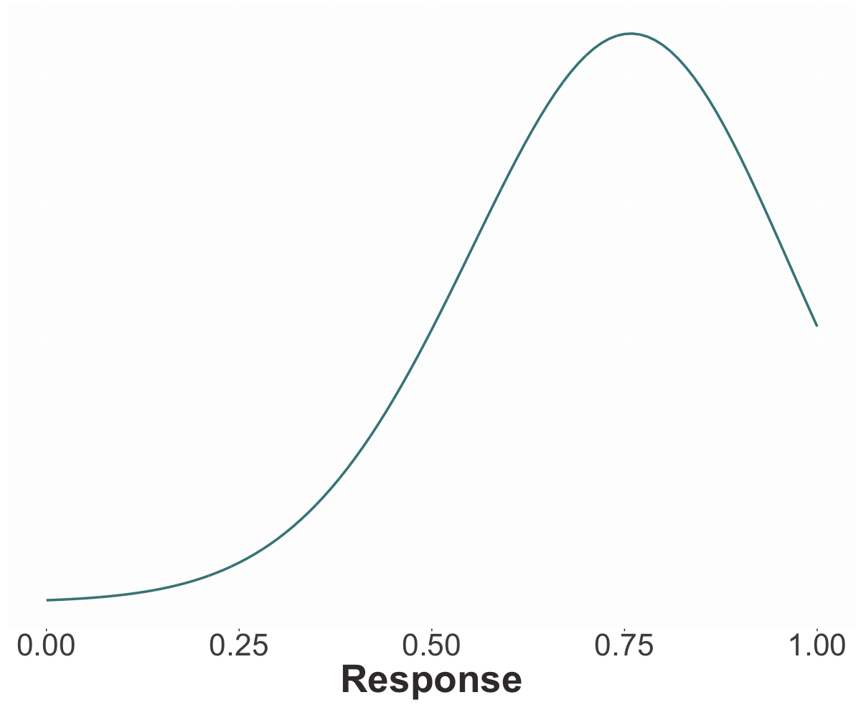

Slide 82
Nonresolution hypothesis
Judgments follow a single distribution whose expected value is determined by the predicate + embedded content.
Resolution hypothesis
Judgments follow a mixture of three distributions: the FALSE and TRUE distributions, determined by the predicate, and the PRIOR distribution, determined by EC.

Slide 83
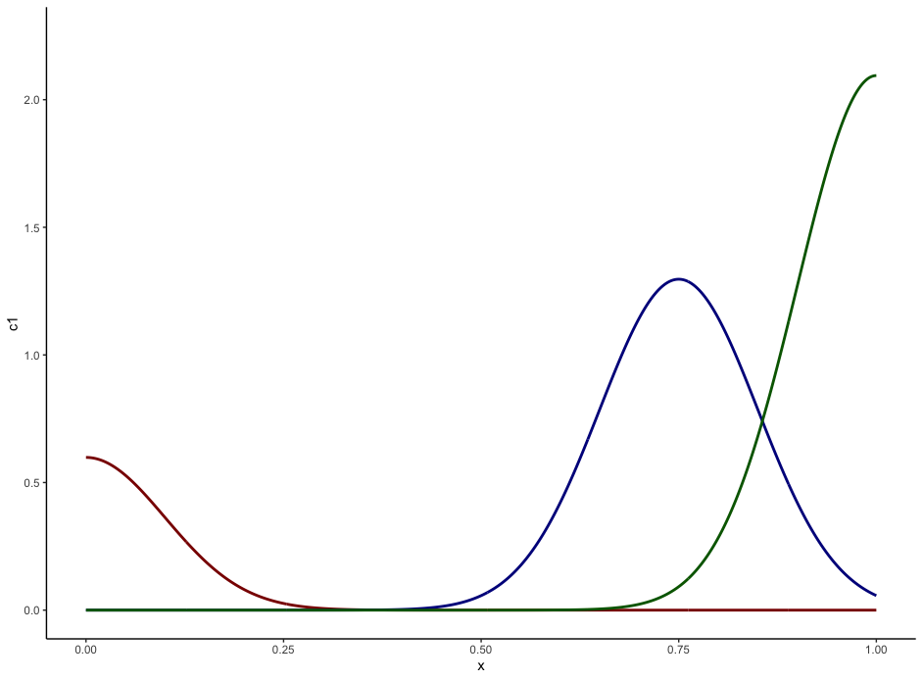
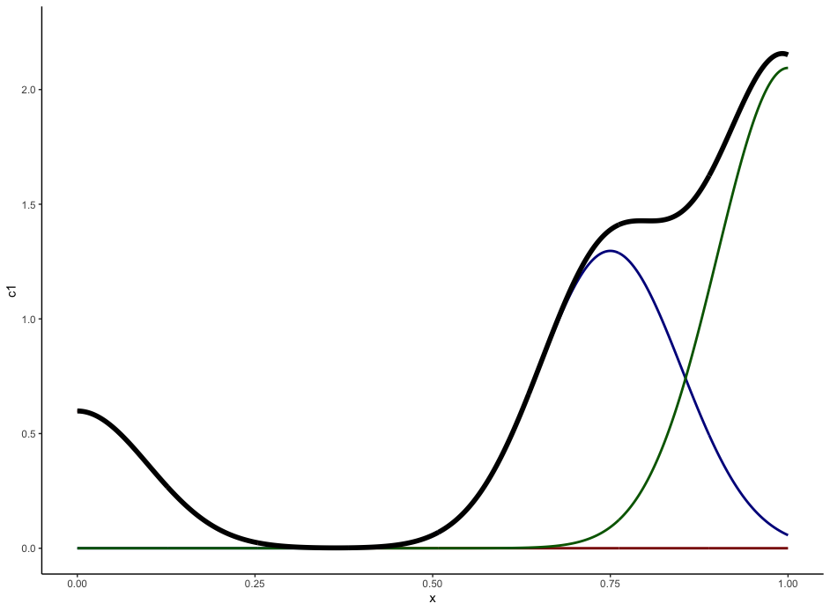
TRUE
PRIOR
FALSE

Slide 84
Model Compilation
Data

Slide 85
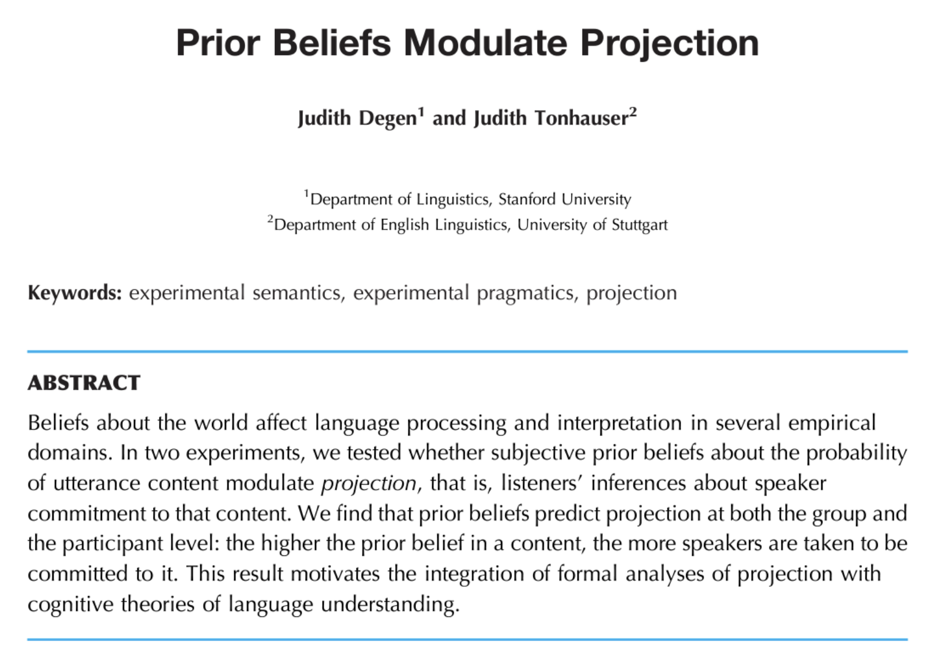

Slide 86
Norming Dataset
Measure prior knowledge: rate likelihood of proposition P given fact F.

Slide 87
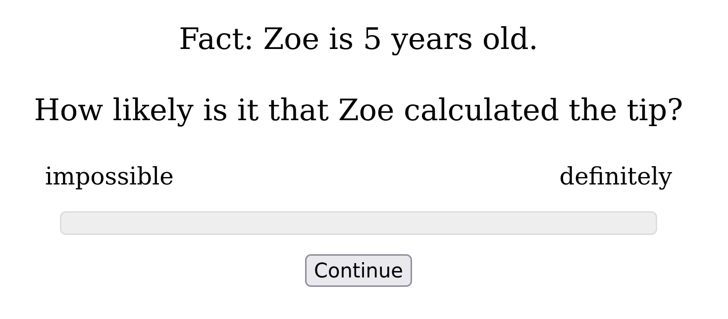

Slide 88
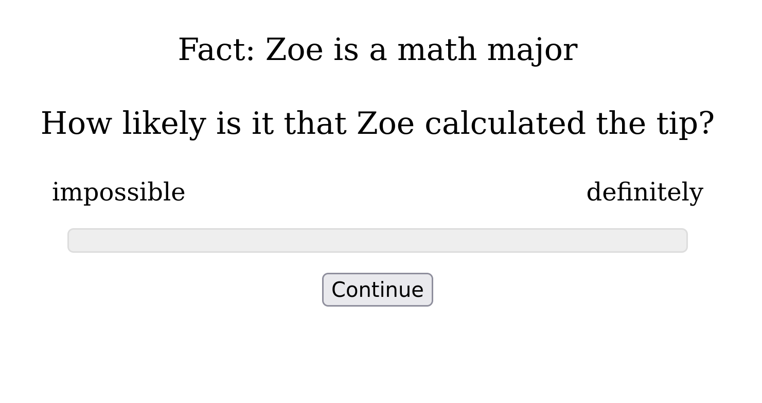

Slide 89
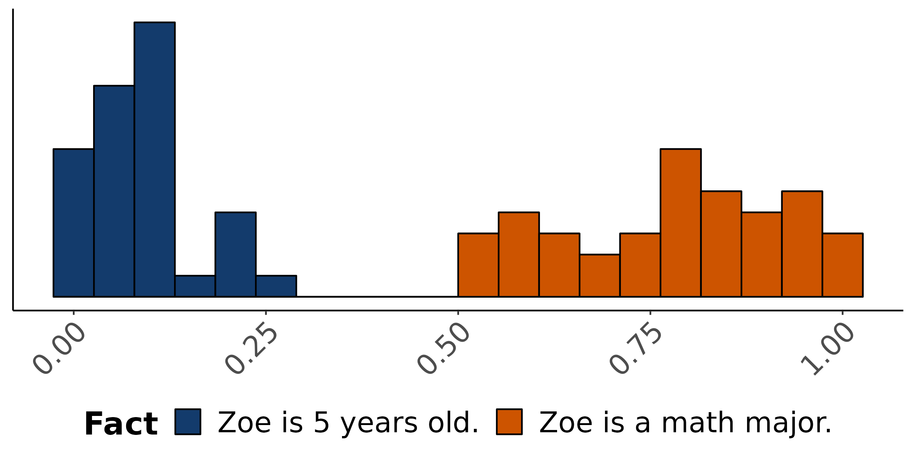
Empirical distribution of norming response
How likely is is that Zoe calculated the tip?

Slide 90
Norming Dataset
Measure prior knowledge: rate likelihood of proposition P given fact F.
Projection Dataset
Measure veridicality inferences: rate X’s certainty that P given F and a context where X asks Did/Does Y V that P?

Slide 91
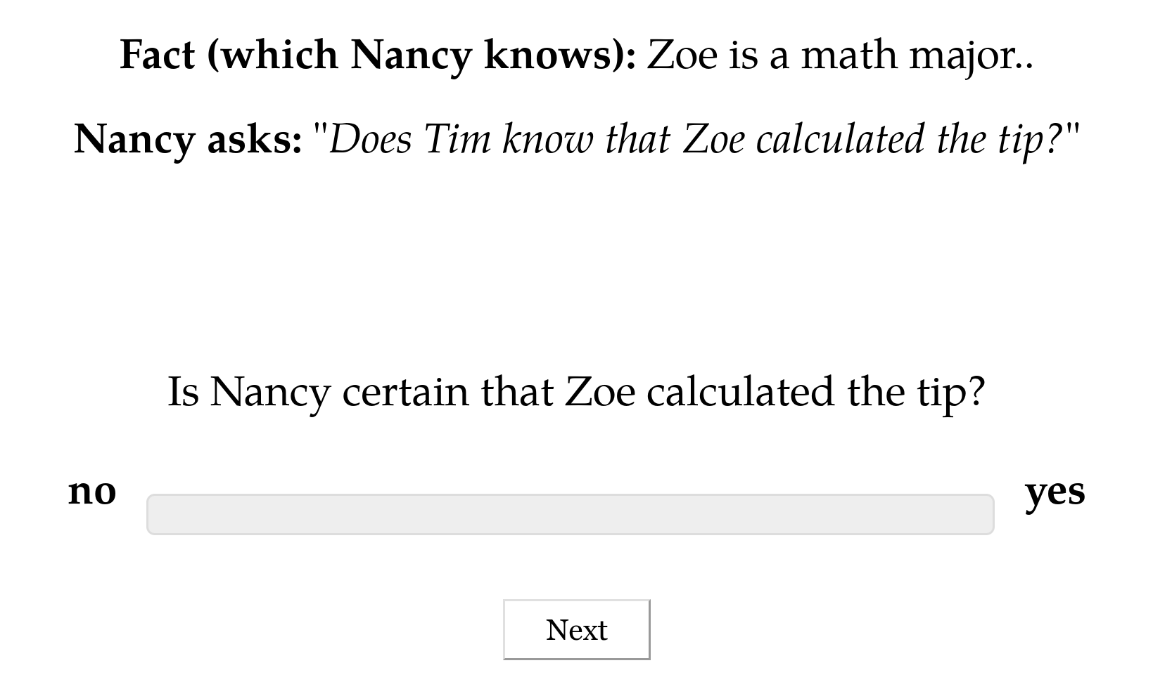

Slide 92
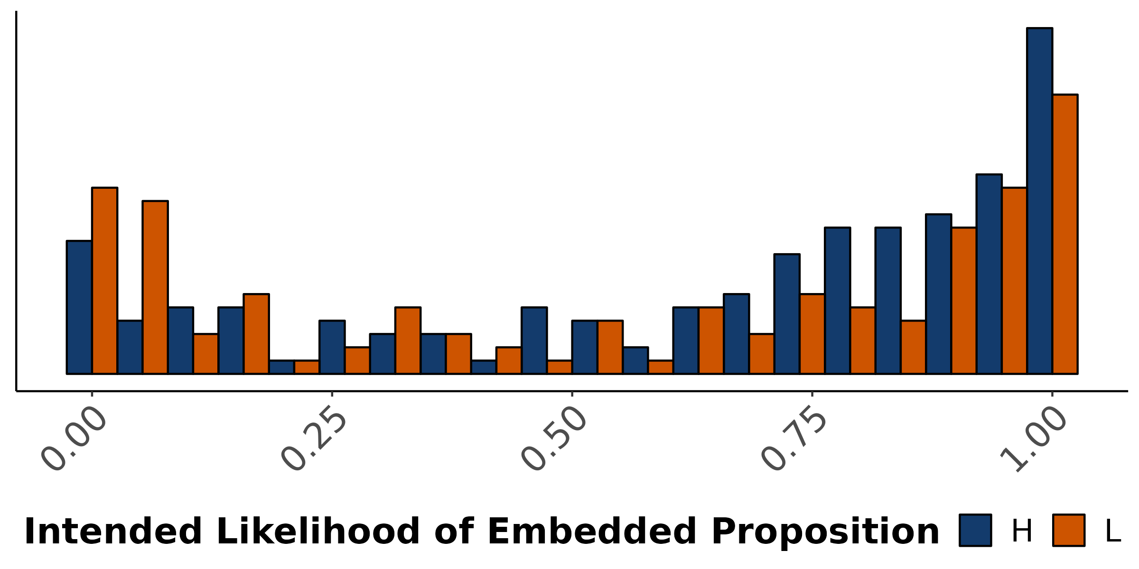
Empirical distribution of projection response
X asks: Does Y know that P?
Is X certain that P?

Slide 93
Model Compilation
Response model

Slide 94
Idea
A response model links a discourse to judgments given using some response instrument.

Slide 95
σ
⋄
σ’
assert
σ
κ -> t
σ'
ask
σ'
σ'
⋄
r -> κ -> t
σ’’
σ’’
Response model
Mixed effects model
Sample a state s from some prior knowledge.
Apply the discourse to s and sample a new state s’ from it.
Sample a context c from the common ground at s’.
Compute the maximal answer d to the current QUD at s’ when applied to c.
Sample from distribution on the response instrument that has d as a parameter.

Slide 96
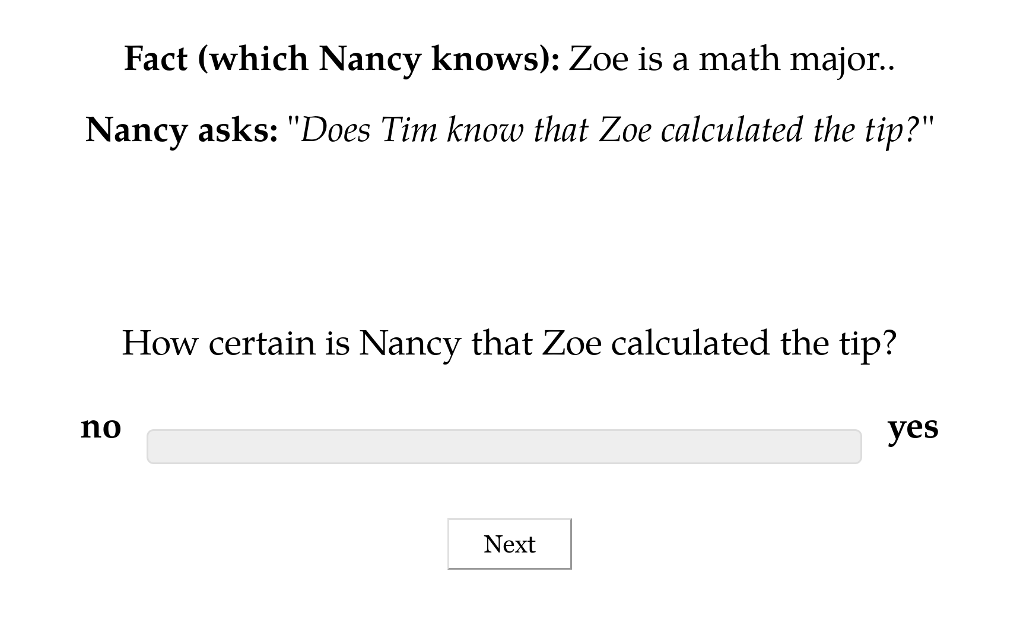
σ
assert
⋄
σ’
σ
κ -> t
σ'
σ'
⋄
assert
σ'
σ’’
κ -> t
σ’’
ask
σ’’
σ’’
⋄
r -> κ -> t
σ’’’
σ’’’
Mixed effects model
Response model

Slide 97
Question
How do we end up with the two distinct models I discussed yesterday?

Slide 98
Nonresolution hypothesis
Judgments follow a single distribution whose expected value is determined by the predicate + embedded content.

Slide 99
Good model of the norming data.

Slide 100
Nonresolution hypothesis
Judgments follow a single distribution whose expected value is determined by the predicate + embedded content.
Resolution hypothesis
Judgments follow a mixture of three distributions: the FALSE and TRUE distributions, determined by the predicate, and the PRIOR distribution, determined by EC.

Slide 101
TRUE
Good model of the projection data.
PRIOR
FALSE

Slide 102
Better model of the norming data.
Nonresolution hypothesis
Judgments follow a single distribution whose expected value is determined by the predicate + embedded content.
Resolution hypothesis
Judgments follow a mixture of three distributions: the FALSE and TRUE distributions, determined by the predicate, and the PRIOR distribution, determined by EC.

Slide 103
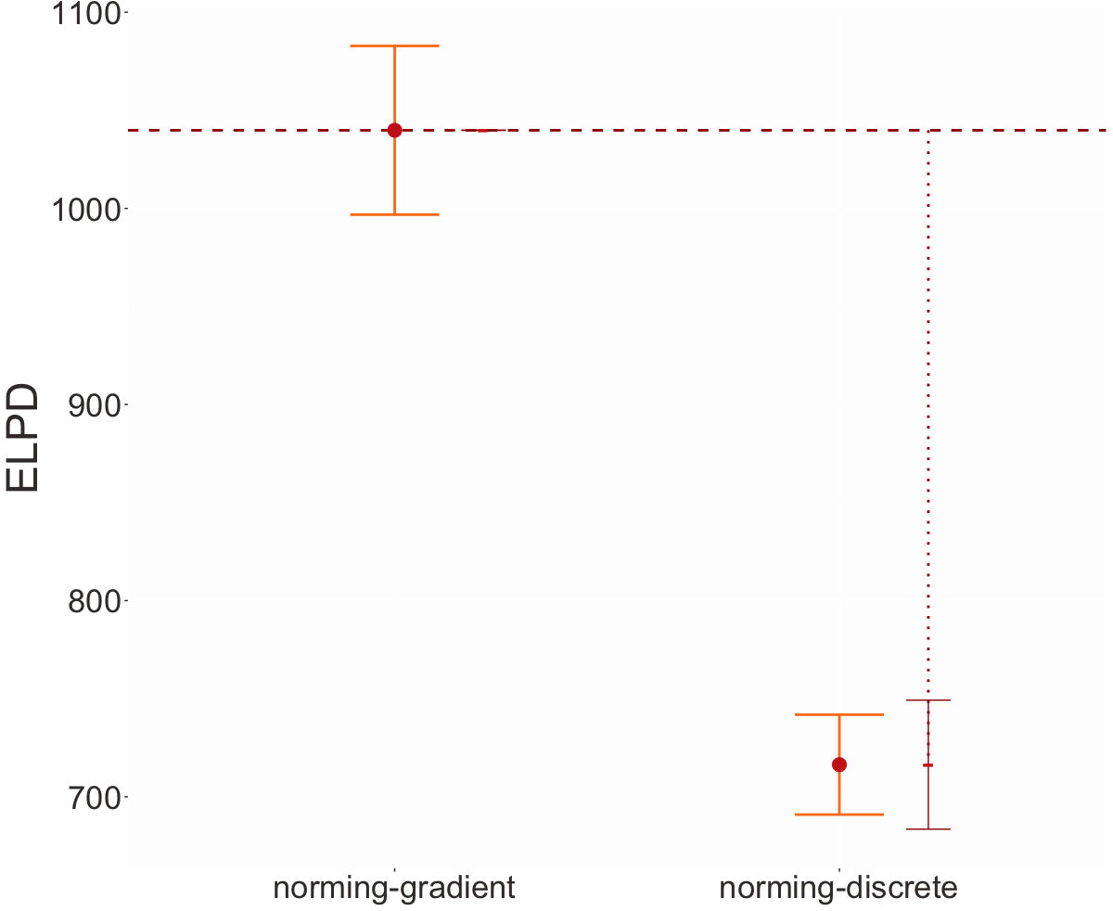
Higher means better fit
Unresolved
Resolved

Slide 104
Better model of the norming data.
Nonresolution hypothesis
Judgments follow a single distribution whose expected value is determined by the predicate + embedded content.
Better model of the projection data.
Resolution hypothesis
Judgments follow a mixture of three distributions: the FALSE and TRUE distributions, determined by the predicate, and the PRIOR distribution, determined by EC.

Slide 105
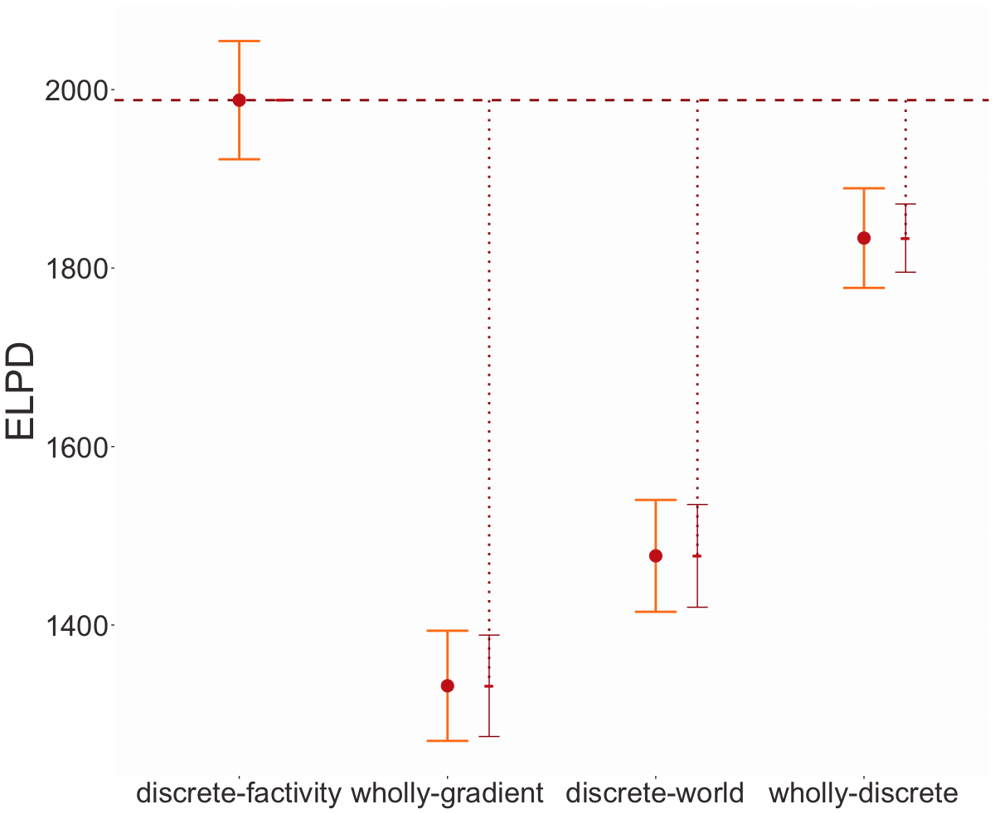
Factivity
Resolved
Factivity
Unresolved
Factivity
Unresolved
Factivity
Resolved

Slide 106
Question
How do we end up with the two distinct models I discussed yesterday?
Answer
These models correspond to different assumptions about whether the answer to varies across contexts or whether it is locked to some other component of the discourse state.

Slide 107
σ
⋄
σ’
assert
σ
κ -> t
σ'
ask
σ'
σ'
⋄
r -> κ -> t
σ’’
σ’’
Response model
Mixed effects model
Sample a state s from some prior knowledge.
Apply the discourse to s and sample a new state s’ from it.
Sample a context c from the common ground at s’.
Compute the maximal answer d to the current QUD at s’ when applied to c.
Sample from distribution on the response instrument that has d as a parameter.

Slide 108
Model Compilation
Application

Slide 109
Question
Is it useful to model inference judgment tasks at this fine-level of granularity?

Slide 110
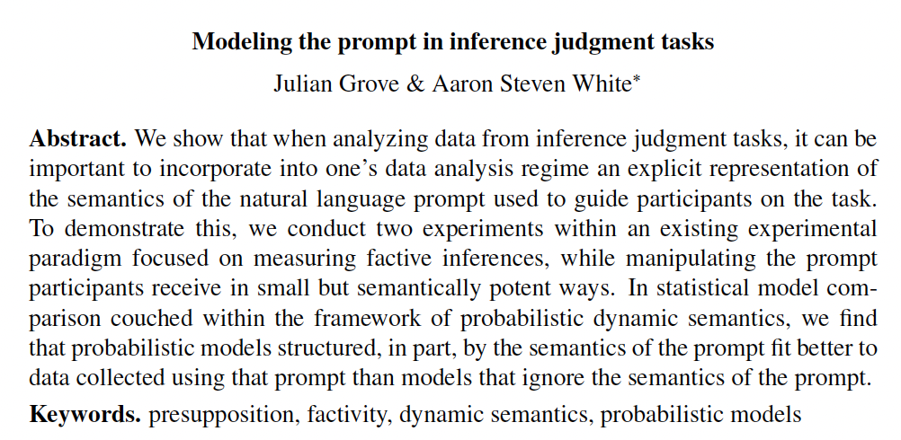
Julian Grove
University of Rochester

Slide 111
Question
If we explicitly model subtle changes to the prompt are we able to fit the data better?

Slide 113
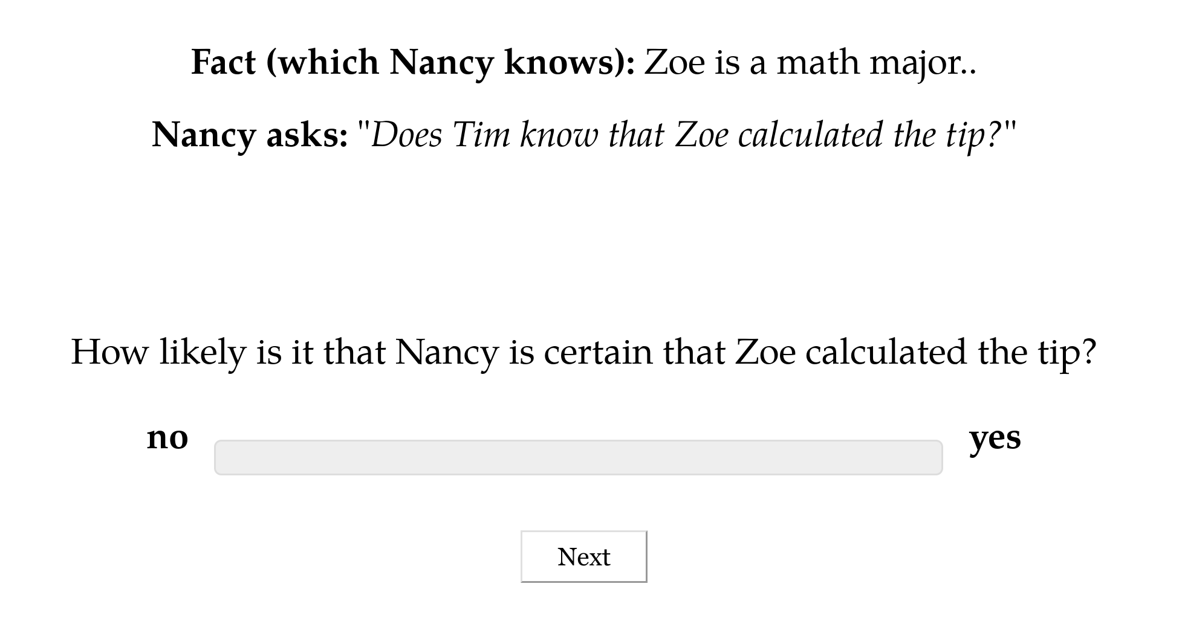

Slide 114
σ
Take a weighted average over the contexts in the common ground of whether the prejacent is true.
(κ -> t) -> r -> κ -> t
σ'
How likely is it that they were secretly pleased?
σ
All questions in our system are short answer questions.
r -> κ -> t
σ'
Hausser and Zaefferer 1978; Hausser 1983; Xiang 2021; cf. Hamblin 1973; Karttunen 1977; Groenendijk and Stokhof 1984
Input
Discourse
ask
Output
Discourse
σ
σ'
σ
⋄
⋄
⋄
σ'
σ’’
σ’’
ask creates a program that:
Samples a state-monadic question from the expression’s semantic value.
Sets the QUD.

Slide 115
Take a semantic value directly from Klecha 2012 (see also Goodman 2023)
[[certain]] thresholds a confidence scale that is lower-bounded by the probability of the utterance.

Slide 116
Factivity
Resolved
Unresolved

Slide 117
Conclusion

Slide 118
Goal
Develop a framework that views probabilistic reasoning as arising from a module that can be added to a dynamic semantic analysis without changing its structure.
Upshot
Allows us to distinguish different kinds of uncertainty at a fine level of granularity.

Slide 119
Feature #1: Compositionality
Complex probabilistic semantic values are derived from simpler ones using a standard type composition scheme.
Use monads!
Feature #2: Modularity
Traditional semantic analyses may be lifted into the probabilistic setting w/o tampering w/ their core structure.

Slide 120
Feature #3: Formal Evaluability
Probabilistic dynamic semantic values can be compiled to statistical models whose relative fits to experimental data can be quantitatively compared.

Slide 121
Future Work
Fully integrate Probabilistic Dynamic Semantics with Rational Speech Acts.

Slide 122
Thanks!

Slide 123

Supported by NSF-BCS-1748969
The MegaAttitude Project: Investigating selection and polysemy at the scale of the lexicon

